Slide 1
VEHICLE NUMBER PLATE DETECTION
Machine learning

Slide 2
Abstract
Variety plate recognition is a photograph processing technology that uses quantity (license) plate to perceive the vehicle. The objective is to design efficient automated authorized automobile identification gadgets with the aid of the usage of car number plates. The gadget may be implemented on entrance for safety control of a fantastically restricted location like navy zones or regions around top authorities offices e.g. parliament, ideal court, and so on. The evolved machine first detects the vehicle and then captures the automobile photo. The car range plate area is then transformed into a grayscale. The gadget is skilled in the use of a large dataset of automobile pictures and number plates below numerous lights and environmental situations. This data can be used to find the vehicle’s owner, place of registration, address, etc. it is determined from the test that the evolved gadget effectively detects and recognize the automobile’s wide variety of plate on actual snapshots

Slide 3
Introduction
Because of the increasing variety of motors these days, the modern-day town needs to establish an effective and efficient automatic device for the management of the site visitor’s law enforcement. Range plate reputation leads a large role in this condition. The variety plate reputation is a photograph processing method to extract the image of the registration code on the automobile taken by using a digital camera or taken via either a coloration or a grayscale digital camera, as an infrared digital camera for you to identify the motors and the use of their range plate.
The need for residential parking areas involves a completely large wide variety of the populace staying in towns and in turn, assesses cozy and smooth parking areas that are used these days. The legal car registration inside the parking control device together with proprietor statistics is saved in the system. Whenever the vehicle enters or goes away parking lot, will trigger actual time statistics reflecting the ingression of the stated system gaining knowledge of procedures and the trouble in an extraordinary way.

Slide 4
Methodology
Image Acquisition: The first step is to acquire the image of the vehicle that contains the number plate. The image can be obtained using a camera or from pre-existing images or videos.
Pre-processing: The acquired image is then pre-processed to remove any noise or unwanted elements that may hinder the number plate detection process. This can include resizing the image, adjusting brightness and contrast, and applying filters such as blur or edge detection.
Region of Interest (ROI) Detection: In this step, the potential regions of interest are identified in the pre-processed image. These regions typically contain the number plate and are identified using techniques such as edge detection, color segmentation, or template matching.
Character Segmentation: Once the regions of interest are identified, the individual characters in the number plate are segmented. This involves separating each character from the rest of the plate, and ensuring that there is sufficient space between each character for accurate recognition

Slide 5
Methodology
Character Segmentation: Once the regions of interest are identified, the individual characters in the number plate are segmented. This involves separating each character from the rest of the plate, and ensuring that there is sufficient space between each character for accurate recognition.
Character Recognition: In this step, each segmented character is recognized using Optical Character Recognition (OCR) techniques. OCR algorithms analyze the features of the segmented characters and compare them to a database of known characters to determine their identity.
Post-processing: Finally, the recognized characters are combined to form the complete number plate, and any errors or inconsistencies in the recognition process are corrected. The output can be further processed to obtain additional information such as the state or country of registration, vehicle makes and model, and more.

Slide 6
PROPOSED SYSTEM
He proposed system will routinely apprehend unauthenticated car by using the usage of automatic wide variety plate popularity gadget. record of authenticating car in residential regions could be stored on the database. on every occasion the automobile arrives at the parking system, the sensor detects the presence of car and the digicam takes the image and extracts the wide variety from wide variety plate
The metamorphosis of facts from video cameras right into a new dimension is an try to offer imagination and prescient to laptop and device gaining knowledge of to learn activities carried out by way of computer. Open cv library is supported with many picture processing capabilities and amenable to all running structures.
It particularly specializes in real time photo processing to apprehend automobile range plate.The diagnosed range on the plate is matched with the recorded database. If the quantity does not fit the car is denied access as an un-authenticate, main to the gate remaining closed and the humming of alarm which in flip sends a message to parking control authority via GSM .it is able to also be displayed on a cellphone

Slide 7
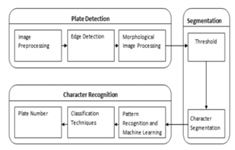
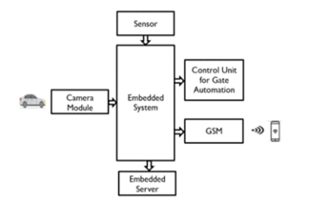

Slide 8
Edge Detection-Edge is a boundary between two regions with relatively distinct gray level properties. It detects discontinuities in intensity values. The basic step in the recognition of a plate is to detect plate size (rectangle), thus we have to detect the edge of a rectangular plate. Using the Sobel operator, the edges in the image are highlighted. This in turn reduces the amount of data in the image and processes the required data for further use.
Segmentation-Character segmentation is a bridge between a number plate extraction and character recognition. In this, different characters on a number plate area are segmented. Various reasons such as lighting variance, plate frames, and rotation are those which hinder the segmentation work. A segmentation method is also known as a boundary box analysis. By this method, characters are assigned to connected components and these are extracted using the boundary box analysis. The segmentation process is completed upon the reduction of noise in the image.

Slide 9
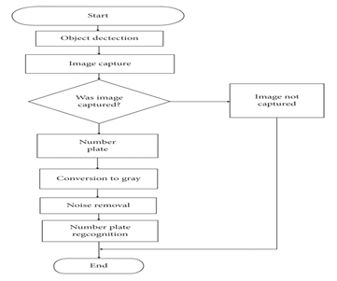
EXISTING SYSTEM
The present system to determine the details of a car calls for a variety of human interaction which also leads to human mistakes. As an example, the e-challan fine by way of the traffic officials is as follows.
A CCTV digital camera constantly statistics pictures of the continued visitors. If a motorist breaks any traffic rule, the act can be recorded within the pictures. The police will try and extract the quantity from the car’s display shot captured from the CCTV photos and the offense will be registered inside the facts. This method requires plenty of humanitarian aid which may be decreased through the usage of the subsequent set of rules to understand the registered car variety.

Slide 10
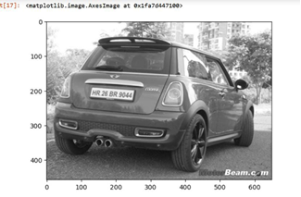
IMPLEMENTATION
Photograph Acquisition :-
ANoIR enabled digicam equipped for taking infrared photos up to 3280×2464 pixels is applied. This digicam is likewise equipped for catching video at 1080p30, 720p60
And 640×480p90 desires which is a brilliant video. to diminish the computationalon machine,[18]a digicam association to seize snapshots with just 640×480 pixels can be used.

Slide 11
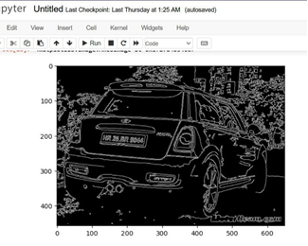
Image Thresholding:
Thresholding is nothing but the process of converting a grayscale image and generating a bi-level image which is easier to detect edges. It does not identify the main objects, but instead, it separates them from the background to retrieve the information that we have to work with.
At the time of thresholding , it is very important to set the correct value of the threshold which will best find a pixel as an object or a background. We use OpenCV's cv Threshold to achieve

Slide 12
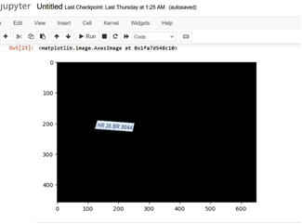
Segmentation:
Image Segmentation is the way toward apportioning a picture into various parts which is then used to recognize objects or other pertinent data in advanced pictures. After the morphological change, 2 fragments were distinguished as potential up-and-comers as delineated in underneath Figure.
The fragments will at that point experience another significant procedure where the model will figure out which one has the best conceivable character. The fragment will at that point be segregated into a square-formed picture, and it is tried with the goal that the longest rundown of potential characters will be found and decided as the conceivable genuine number plate. The last picture with the most potential characters in it will at that point be picked to go for character acknowledgment in the following procedure

Slide 13
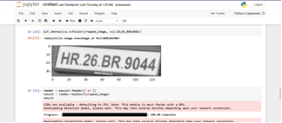
RESULT
The figure shows python model training to detect and recognize license number plate. The below output is achieved by running the python program which trains the model using the training dataset and saves the model by using python libraries. Then a predictor file is run with a test image which is not included in the training dataset and gets recognized and for better visibility of detection the license plate area is marked by a red border.

Slide 14
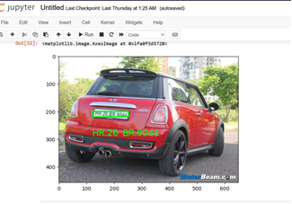
Initially, the camera will be used to capture the image. Once the image is captured, the algorithm will process it by converting it into grayscale, followed by extracting the possible number plates and finally recognizing the registration number of the vehicle. The final registration details will be searched from the database and will be displayed on the screen.

Slide 15
CONCLUSION
Machine Learning Algorithms such as KNN are very effective for vehicle number plate recognition using machine learning. It consists of the outcomes of the result analyzed based on the various parameters such as recognition of individual characters and a digit success ratio of recognition for the success of identifying the selected set of a character from a group of characters and digits. From the results, we can conclude that number plate recognition will perform better as the quality of the camera used for scanning the plate will be excellent. Using low-quality cameras will degrade the performance and may misclassify the characters.
The proposed technique for wide variety of Plate Detection and reputation for the use of deep-studying, landed up with an accuracy ofninety-eight-.forty six% for the RCNN version and an accuracy of 95. ninety eight% for the CNN model, resulting in sincere findings. As an end result, the proposed methodology reveals a method to the recognized

Slide 16
References
S Hashmi, K Kumar, and S Mittal. ”Real Time License Plate Recognition from Video Streams using Deep Learning” International Journal of Information Retrieval Research, vol.9, pp. 65-87, 2019.From Kaggle. Character recognition from number plate. https://www.kaggle.com/kdnishanth/ characterrecognitionfromnumberplate
Maulidia R. Hidayah1, Isa Akhlis2, Endang Sugiharti3” Recognition Number of The Vehicle Plate Using Otsu Method and K-Nearest Neighbour Classification”, Scientific Journal of Informatics Vol. 4, No. 1, May 2017.
Liu, W.-C., &Lin, C.-H. (2017). “A hierarchical license plate recognition system using supervised K-means and Support Vector Machine”, 2017 International Conference on Applied System Innovation(ICASI).
WIKIPEDIA https://en.wikipedia.org/wiki/Automatic_number-plate_recognition/apr 2020

Slide 17


